Slide 1
Dungeons and Dragons Interactive Character Sheet
By Peter Hiesel and Ryan Costello

Slide 2
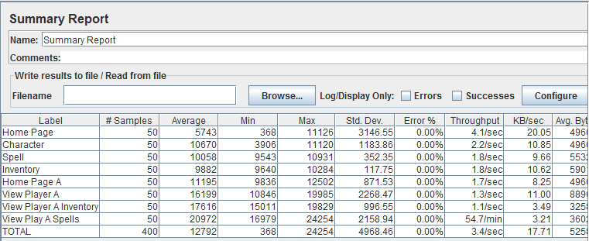
Load Testing - Before
Jmeter results:
Our load times in milliseconds were up to 16,000 on average with 50 users.
Bottleneck in our Player’s Show.erb.html page.

Slide 3
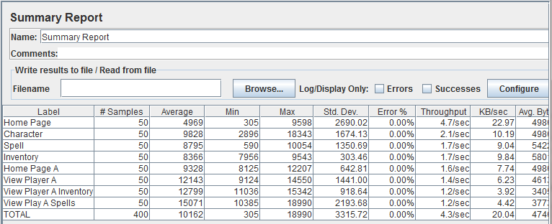
Load Testing - After
Jmeter results:
Our load times in milliseconds were up to 11,000 on average with 50 users.
Bottleneck in our Player’s Show.erb.html page.

Slide 4
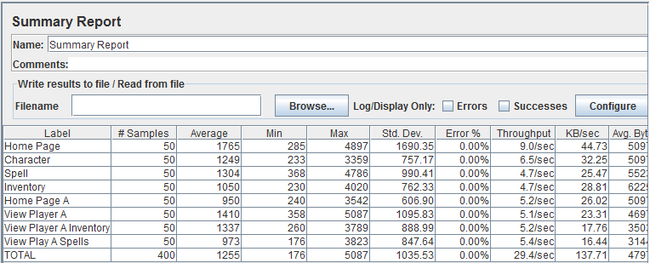
Heroku – Load Times
Jmeter results:
Our load times in milliseconds were up to 1,000 on average with 50 users.
This concludes our best time, and bottleneck problem solved.

Slide 5
Bugs
Issue with updating player with a new name.
Issue update player name with a blank.
Issue update item name with a blank.
Issue update health could enter letter.
Issue update health had no limit on value.

Slide 6
Selenium Testing
Please enjoy our Selenium test cases.

Slide 7
Q and A team for Hangman
User Acceptance Test – There was 4 test cases in bugs/errors. Then 9 user acceptance test cases. Also, there was 4 other possible bugs.
Load Testing – Jmeter was able to get through the login page as well get all pages.
Bottle Neck Profiling – Jmeter’s summary report on average load times showed “Current Game” page was the issue.

Slide 8
The End

